Slide 1

Exploratory Data Analysis
G2M insight for Cab Investment firm
8th Aug 2019

Slide 2

Agenda
Executive Summary
Problem Statement
Data Exploration
Approach
EDA
EDA Summary
Recommendations

Slide 3
Background –G2M(cab industry) case study
XYZ is a private firm in US. Due to remarkable growth in the Cab Industry in last few years and multiple key players in the market, it is planning for an investment in Cab industry and as per their Go-to-Market(G2M) strategy they want to understand the market before taking final decision.
The analysis is divided into following parts-
Data Exploration
Trends and Patterns in Various Profit forms ( Average Profit, Profit Percentage and Profit per KM)
City wise EDA
Payment Method Analysis
Customer Analysis

Slide 4
Problem Statement
Perform EDA on given Datasets to get-
Profit Insights
City wise investment opportunities
General trends in customers

Slide 5
Data Exploration
 | Number of Observations | Null Values | Derived Features | Total Features
Cab_Data | 359391 | None | 4 | 10
Customer_ID. | 49170 | None | 0 | 4
Transaction_ID | 440097 | None | 0 | 3
City | 20 | None | 1 | 4
Master Data | 359392 | None | 5 | 15
City
Transaction
Customer
Cab
Master Data

Slide 6
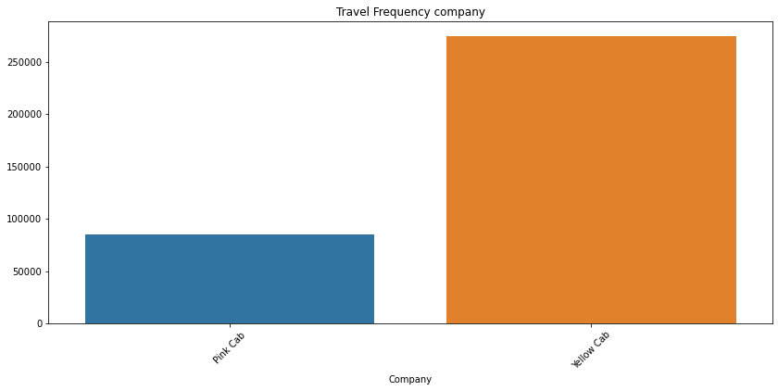
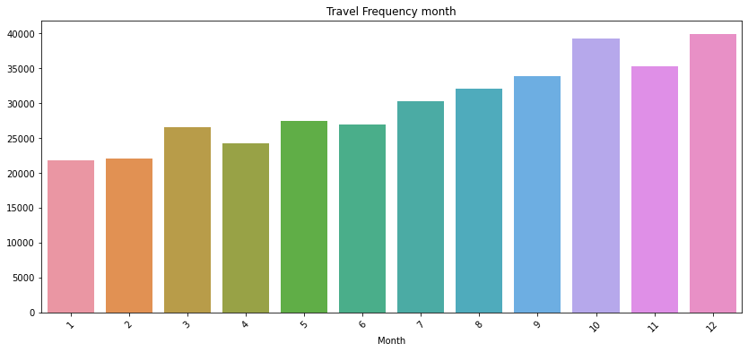
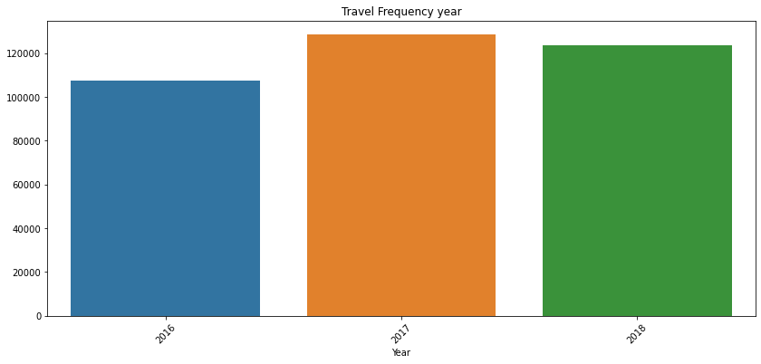
General Trends
Yellow Cab is used more than Pink Cab.
76.4% of the rides are by Yellow Cab
October and December have slightly higher frequency of cab rides then other months, with January and February being the lowest
2017 has the highest cab rides and the 'Year" column approximately has fairly distributed data

Slide 7
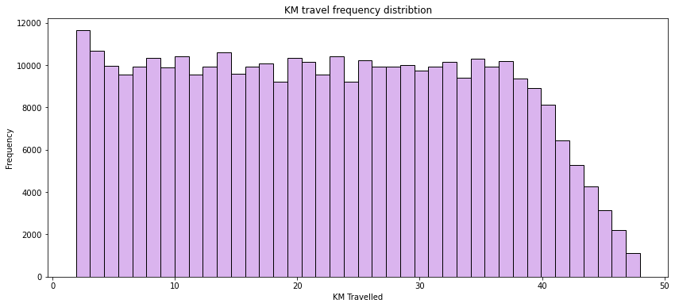
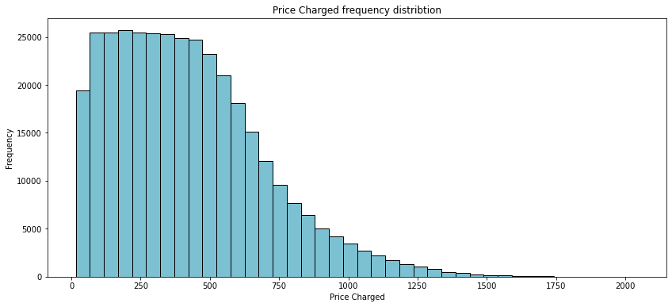
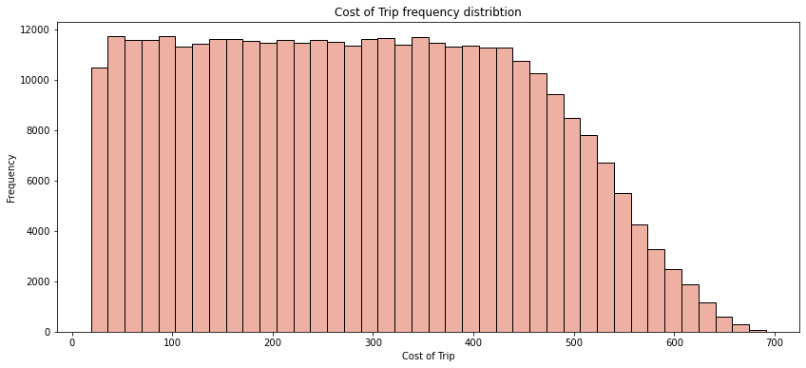
General Trends
After 40KM there is gradual linear decrease in number of rides
After 400, there is an exponential decrease in number of rides
After around 420 there is linear decrease in number of rides till it reaches 0 around 700

Slide 8
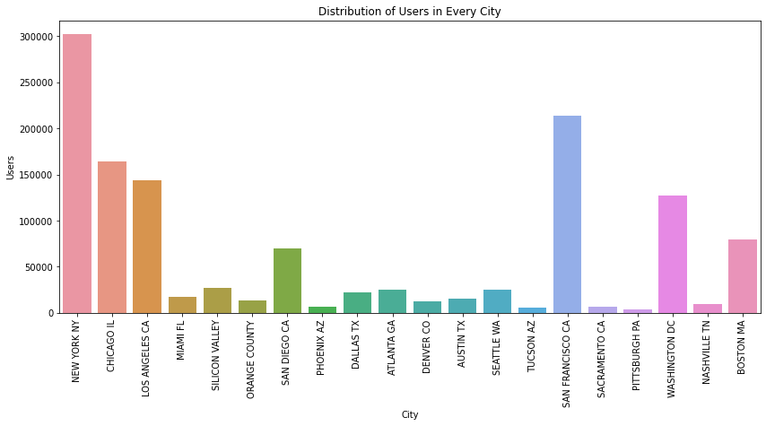
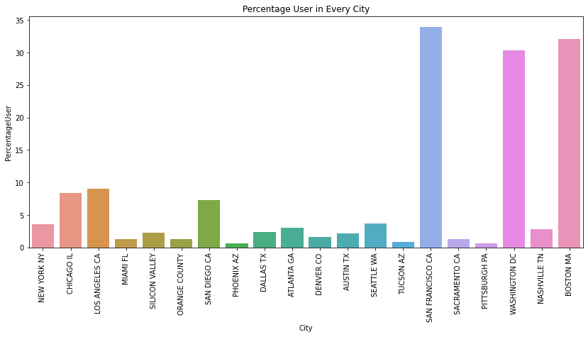
City Analysis
(Percentage users = user/population)
Even if NY has maximum users, San Francisco has the highest percentage of users.
Cities with high number of users but low percentage users can be a potential market for investment opportunities (E.g. NY, Chicago and LA).
Cities with both low users and percentage users, would require more focus since people there in general don’t travel via cab.
Graph1: No of users vs City
Graph2: Percentage user vs City

Slide 9
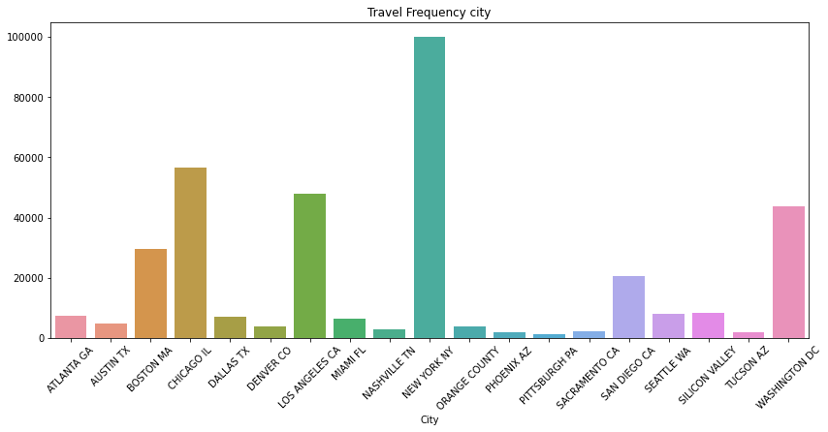
City
(above two graphs are from the previous slide)
New York Contributes most in number of cab rides.
Cities like Boston, Chicago and Washington are potential enough to generate greater travel frequency
Even if San Francisco contributes towards users we don’t have any travel records in San Francisco.
Graph: Total Number of Rides vs City

Slide 10
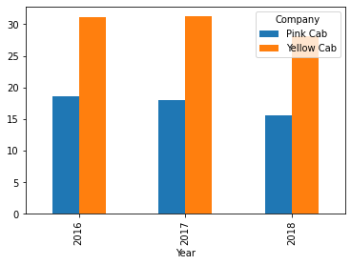
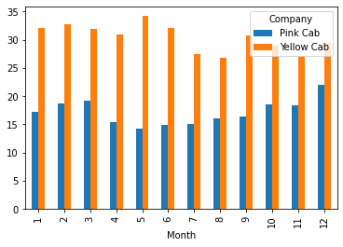
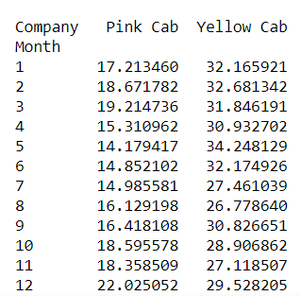
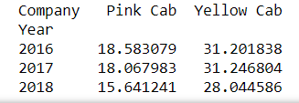
Profit Analysis
Year vs Profit Percentage
Months vs Profit Percentage

Slide 11
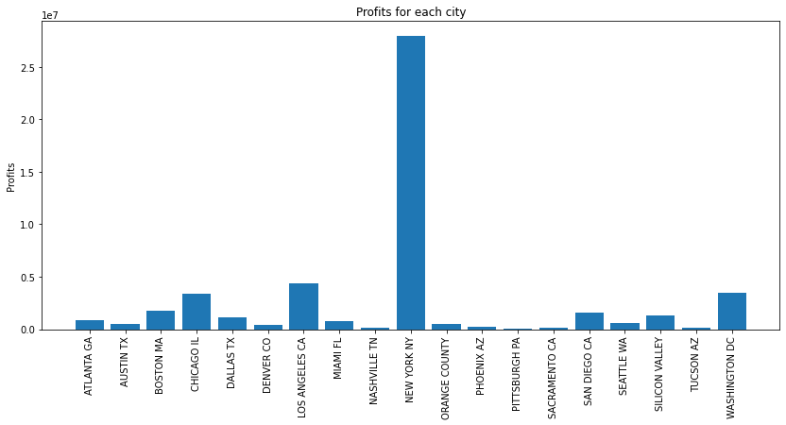
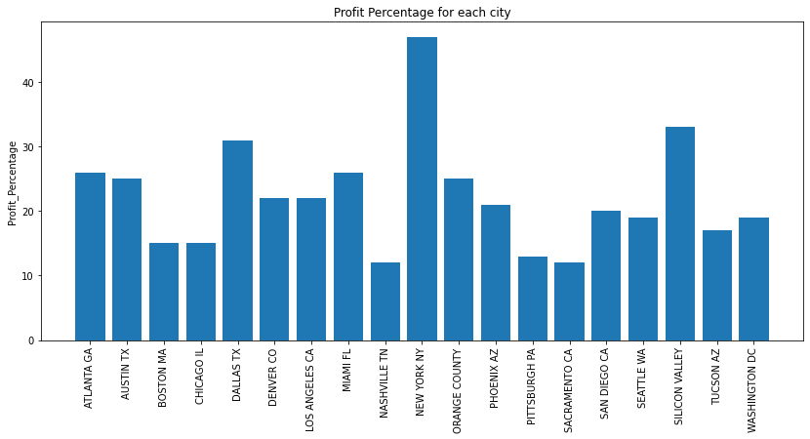
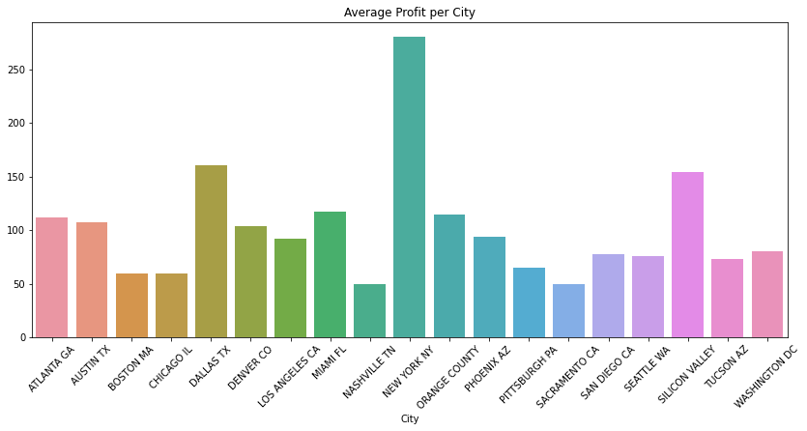
City
(Also refer graph from slide 8 – Travel Frequency)
Dallas and Silicon Valley has comparatively lower travel frequency but higher average profit
Profit and average profit have relatively different graphs
Travel Frequency Profit ,Average Profit and Profit Percentage have different impacts on different cities
Trends in Profit Percentage and Average Profit graphs are very similar
Graph1: (from left) Total Profit vs City
Graph2: Sum of Profit Percentage vs City
Graph 3: (below)Average Profit Vs City

Slide 12
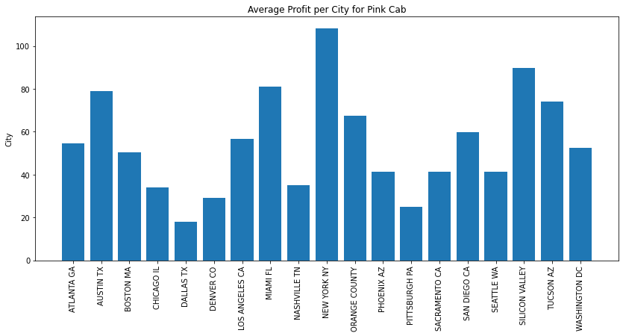
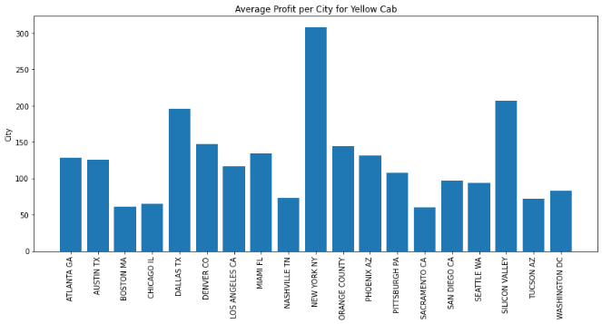
Profit Analysis
Highest Average Profit for Pink City is in New York - 100 , and for Yellow Cab it is 300
For Pink Cab lowest average profit is in the city of Dallas. Yellow Cab has lowest average profit is in the city of Boston
Overall Average profit for Pink Cab – 54.6
Overall Average profit for Yellow Cab- 123.58
Graph1: (from top) Average Profit Vs City for Pink Cab
Graph2: Average Profit Vs City for Yellow Cab

Slide 13
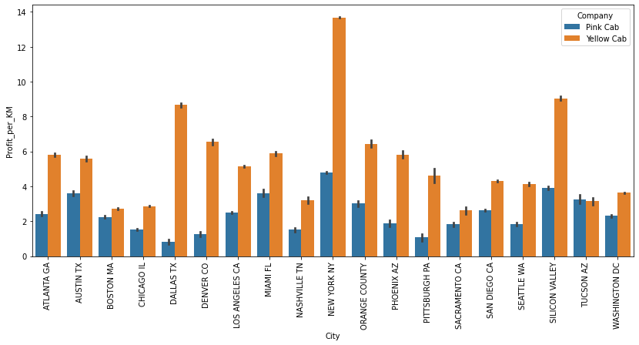
Profit Analysis
Following graph represents Profit per KM vs City for both the company
Dallas, Denver and New York have higher gap for profit per km between the two companies
Tucson is the only city with Profit per KM is higher for Pink Cab

Slide 14
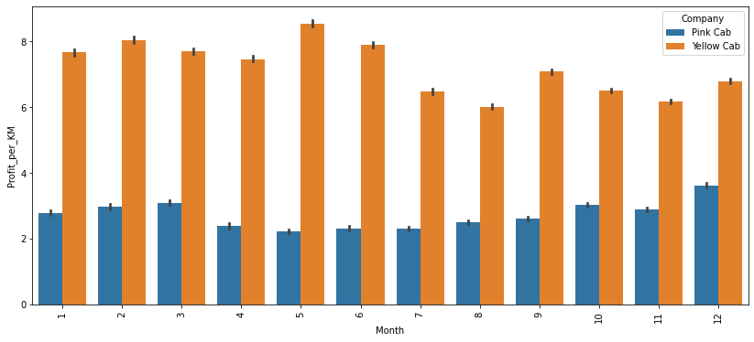
Profit Analysis
The month of May has slightly higher profit per KM while August and November have comparatively lower profit per km

Slide 15
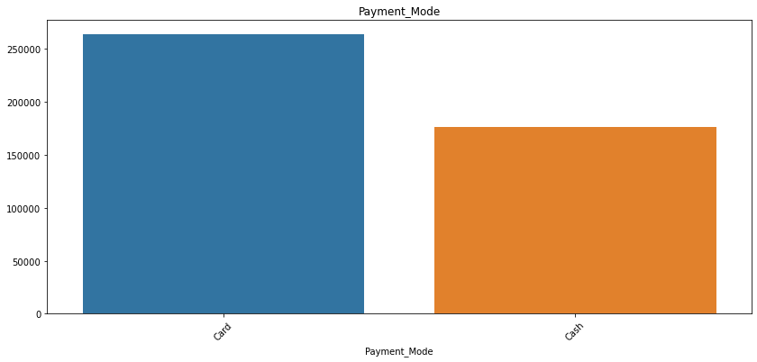
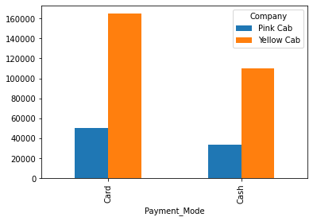


Payment Mode

Slide 16
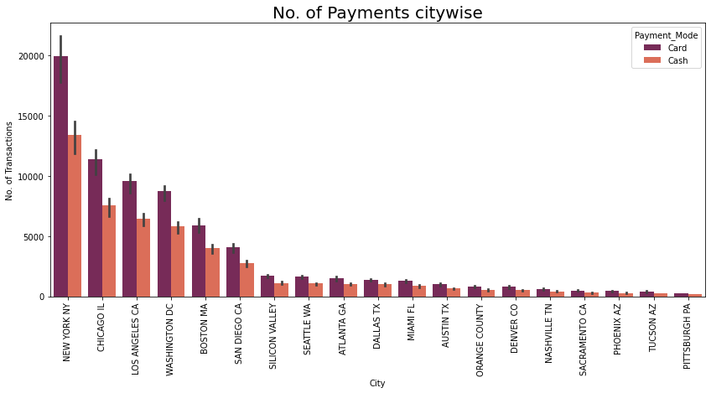
Payment Analysis

Slide 17
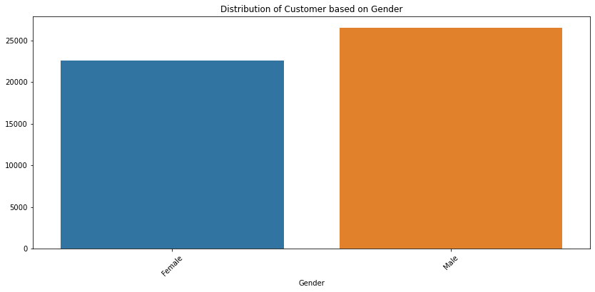
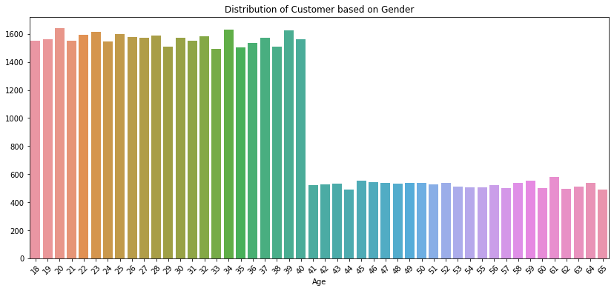
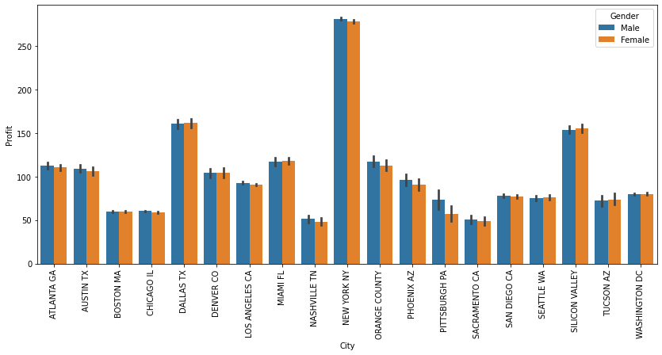
Client Analysis
There are slightly more number of male customers vs female customers
After the age of 40 there is sudden decrease in customers
The trends in the third graph are similar to that of Avg Profit vs City graph in slide 11
Graph1: (from left)Total number of Customers Vs Gender
Graph2: Total number of Customers Vs Age
Graph 3: (below)Average Profit Vs City (for Genders)

Slide 18
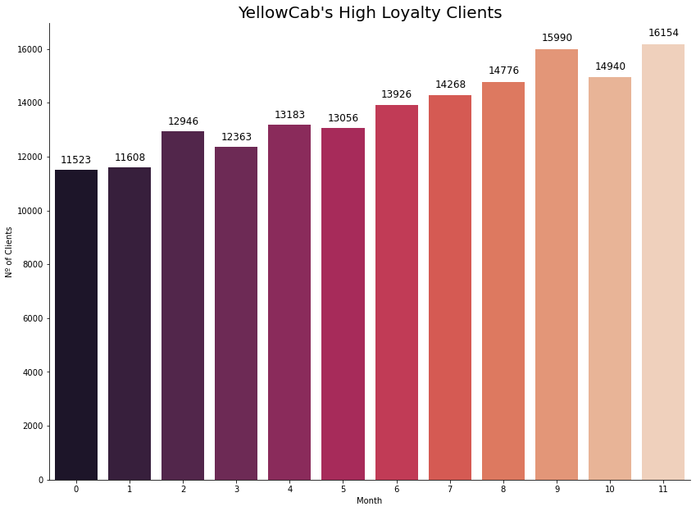
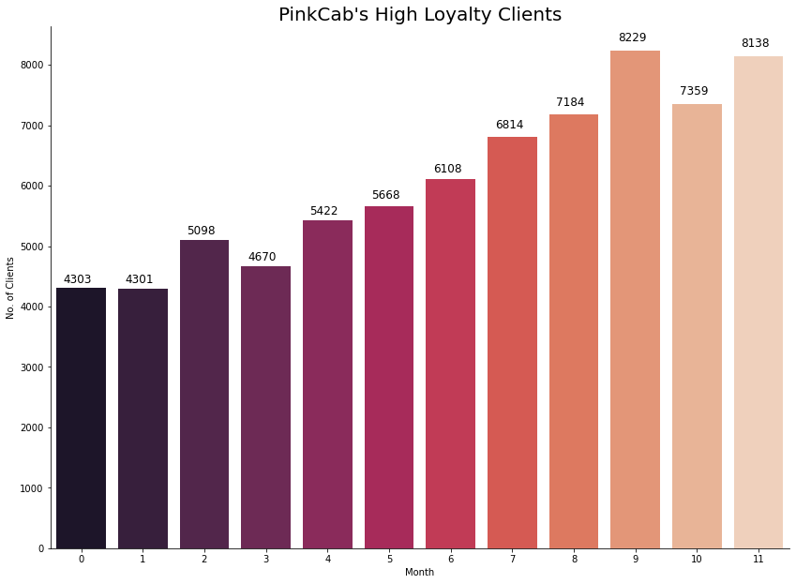
Client Analysis
Both the Cab companies have similar trends in Number of Rides by Loyalty Clients per Months

Slide 19
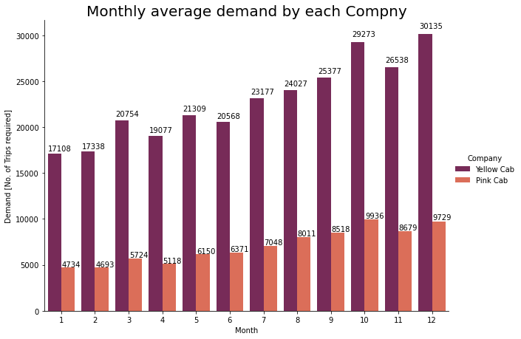
Client Analysis
October and December receives highest customer demands while January and February receives the lowest

Slide 20
Summary
On Average Yellow Cab yields more Profit than Pink Cab
Months of October and December have highest rides and profit yields, while we can increase engagement and number of rides in Jan and Feb by giving discounts.
Profit per KM could be increased for Oct and Dec.
New York is a safe city to invest whereas cities like Boston Chicago and Washington are potential markets
Special scheme can be introduced for people above the age of 40 to encourage them to use cabs more often
Even if number of Males Customers are greater than Females, both the groups generate approximately same average profit trends across cities
We should focus more on cities with comparatively large number of users and lesser user percentage.

Slide 21
Thank You

